Slide 1
Microscope
Definition
A microscope (Greek: micron= small and scope =aim).
Microscope is an instrument for viewing objects that are too small to be seen by the naked or unaided eye.
Microscopy is the science of investigating small objects using such an instrument is called microscopy.
Resolution
Ability to reveal closely adjacent structural details as separate and distinct.
Limit of Resolution
The minimum distance between two visible bodies at which they can be seen as separate and not in contact with each other.

Slide 2
Microscope: Resolution
Types of Microscope | Resolving power
Compound Microscope | 200 nm
Scanning Electron Microscope (SEM) | 10 nm
Transmission Electron Microscope (TEM) | 0.2 nm

Slide 3
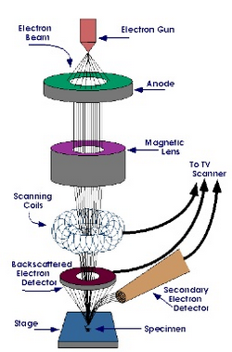
Scanning Electron Microscope
SEM is a scientific equipment that use a beam of energetic electrons to examine objects on a very fine scale.
This type of microscope was developed due to the limitations of light/optical microscope which are limited by the physics of light.
In early 1930’s this theoretical limit had been reached and then there was a scientific desire to see the fine details of the interior structure of the organic cells (nucleus, mitochondria,)
This require 10,000x plus magnification which was not possible existing optical microscopes.

Slide 4
Principle of SEM
A beam of electrons is generated by a suitable source, typically a tungsten filament or a filed emission gun.
The electron beam is accelerated through a high voltage (e.g. 20 kV).
The electrons beam pass through a system of aperture and electromagnetic lenses to produce a thin beam of electrons.
Then, the beam scans the surface of the specimen of the scanning beam in a raster scan pattern and collected by a suitably positioned detector.

Slide 5
Characteristic View of the SEM
Topography
The surface features of an object or “how it looks”, its texture.
Morphology
The shape and size of the particles making up the object.
Composition
The elements and compounds that the object is composed of and relative amounts of them; direct relationship between composition and materials properties.
Crystallographic Information
How the atoms are arranged in the object; direct relation between these arrangements and materials properties.

Slide 6
Basic Parts of the SEM
Electron gun (filament)
Condenser lenses
Objective aperture
Scan coils
Chamber (specimen test)
Detectors
Computer hardware and software.

Slide 7
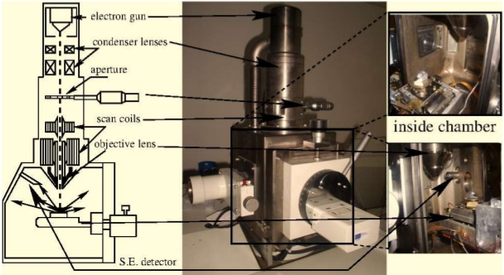
SEM Instruments

Slide 8
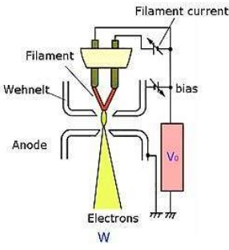
Electron Guns
Electron gun are typically two types.
1) Thermionic guns
2) Field Emission guns
Thermionic guns:
Which are most common type, apply thermal energy to a filament to coax electrons away from the gun and toward the specimen under examination.
It usually made of tungsten, which has a high melting point.

Slide 9
Electron Guns
Field Emission Guns:
Create a strong electrical field to pull electrons away from the atoms.
Electron guns are located either at the very top or at the very bottom of an SEM and fire a beam of electrons at the object under examination.
These electrons don’t naturally go where they need to, however, which gets up to the next component of SEMs.

Slide 10
Electron Guns
Field Emission Guns:
Create a strong electrical field to pull electrons away from the atoms.
Electron guns are located either at the very top or at the very bottom of an SEM and fire a beam of electrons at the object under examination.
These electrons don’t naturally go where they need to, however, which gets up to the next component of SEMs.

Slide 11
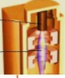
Condenser Lenses
They are not made of glass
Just like optical microscope, SEM uses condenser lenses to produce a clear and detailed images.
They are made of magnets capable of bending the path of electrons.
The condenser lenses focus and control the electron beam, ensuring that the electrons end up precisely where they need to go.

Slide 12
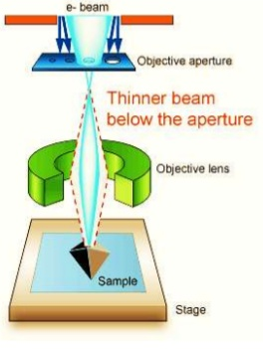
Objective Aperture
The objective aperture arm fits above the objective lens.
It is a metal rod that holds a thin plate of metal containing four holes.
Over this fits a much thinner rectangle of metal with holes (apertures) of different sizes.
By moving the arm in and out different sized holes can be put into the beam path.

Slide 13
Scan Coils
The scanning coils consist of two solenoids oriented in such a way to create two magnetic fields perpendicular to each other.
Varying the current in one solenoid causes the electrons to move left to right.
Varying the current in the other solenoid forces these electrons to move at right angle to this direction (left to right) and downwards.

Slide 14
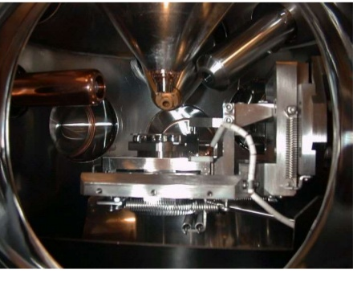
Chamber of Sample Test
The chamber is the place where samples are placed for the examination.
The specimen must be kept extremely undisturbed condition and insulated from vibration to produce clear images.
They also manipulate the specimen, placing it at different angles and moving it so that no need to constantly remount the specimen to take different images.

Slide 15
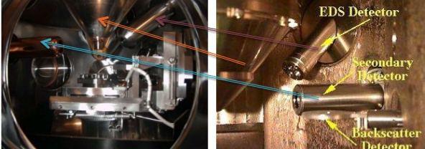
Detectors
Detectors act as a eyes in the SEM.
These devices detects the various ways that the electron beam interacts with the sample object.
For secondary electrons detection used Everhart-Thornley detectors.
Other detectors, such as backscattered electron detectors and X-ray detectors.

Slide 16
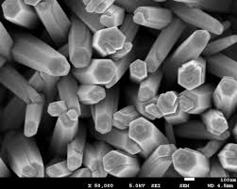
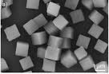
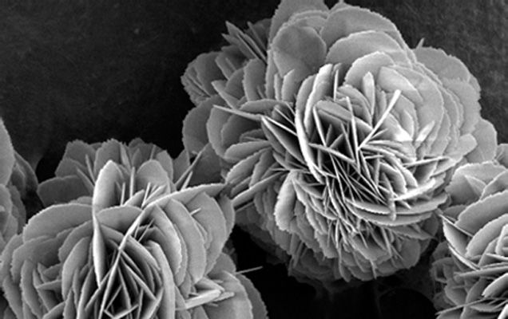
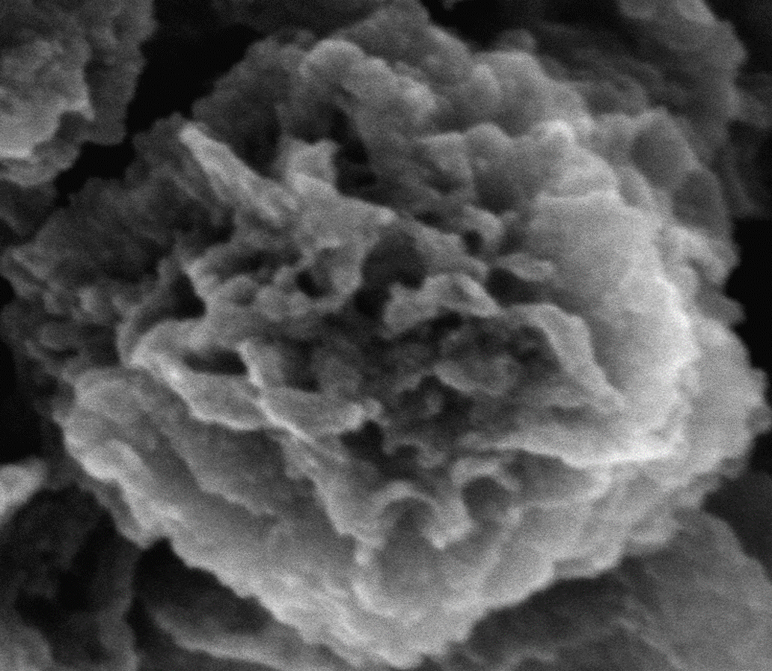
Some SEM Morphology
(b)
100 nm

Slide 17
Applications
SEMs have wide variety of applications in a number of scientific and industrial fields.
It uses to get topographical, morphological and compositional information.
SEM can detect and analyze surface fractures.
SEM provide information in microstructures, examine surface contaminations.
It showed the elemental composition and estimations.
SEMs have practical industrial and technological applications such as semiconductor inspection, assembly of microchips for computers.
SEMs can be essential research tools in fields such as life science, biology, gemology, medical and forensic science, and metallurgy.

Slide 18
Transmission Electron Microscopy (TEM)
Electron Microscopy involve the study of different specimens by using an electron microscope.
Electron microscopes are scientific instruments that use a beam of energetic electrons to inspect the objects on a very fine scale.
Through the use of an electron microscope we can see things that we wouldn’t normally be able to observed with our necked eyes and has greater magnification than optical microscope.
It go beyond 10,000 magnification which was not possible using present optical microscope.
It was developed by Max Knoll and Ernst Ruska in Germany in 1931

Slide 19
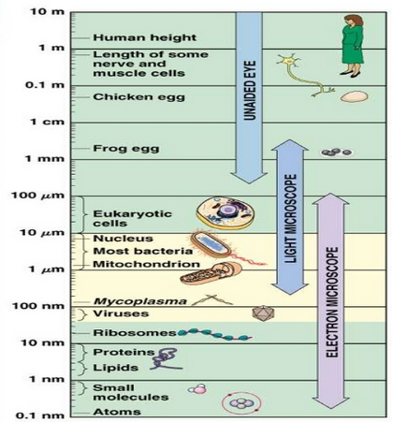
Microscopic Limitations

Slide 20
Principle
TEM is a microscopy technique whereby a beam of electrons is transmitted through an ultra thin specimen, interacting with the specimen as it passes through.
An image is formed from the interaction of the electrons transmitted through the specimen.
The image is magnified and focused onto an imaging device, such as fluorescent screen, on a layer of photographic film, or to be detected by a sensor such as a CCD camera.

Slide 21
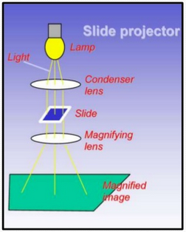
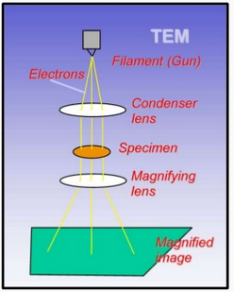
Optical and Electron Microscopy

Slide 22
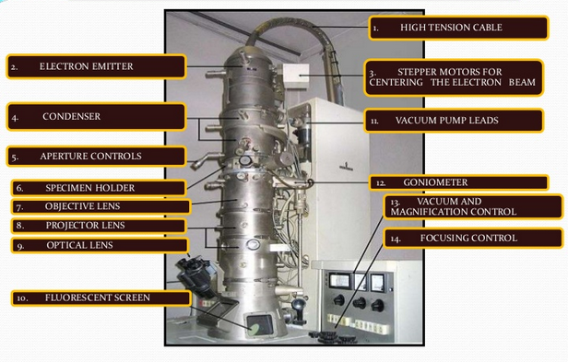
Different Components of TEM

Slide 23
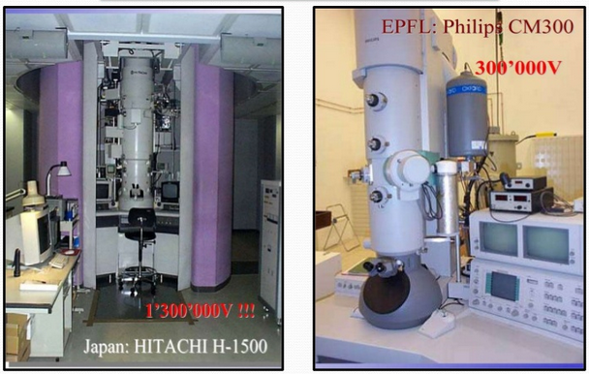
Some Typical TEM Models

Slide 24
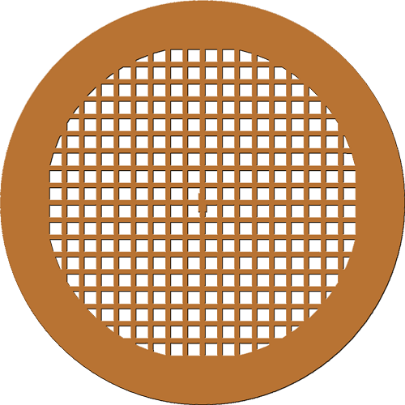
TEM Grids
Grid is a sieve woven from a thin metal wire, usually Nickel or Copper grids of 3 mm diameter are commercially available with different mesh sizes (generally of 50-400 mesh)

Slide 25
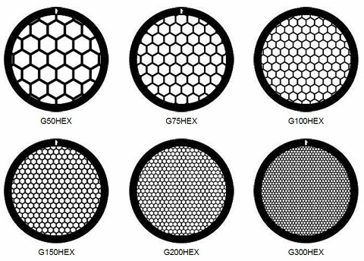
Different Types of Grids

Slide 26
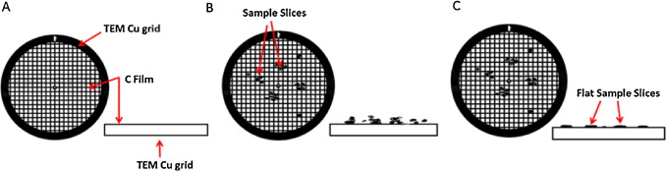
Sample Preparation
You have to disperse a very tiny amount of sample in solvent like methanol, ethanol, acetone.
Selected solvent should be inert towards your compounds.
Solvent should be volatile enough to evaporate the solvent from your compound.
Then, sonicate little while and then drop cast by using capillary tube on surface of TEM grid and allow to evaporate the solvent.

Slide 27
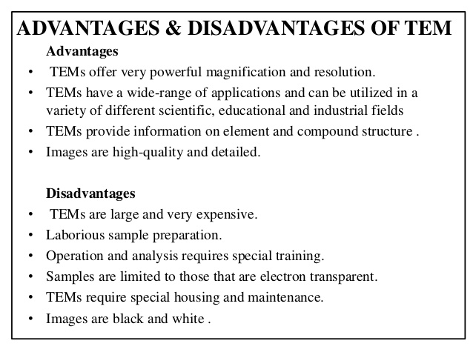

Slide 28
TEM Images
Swapan. K. Das, et.al. Chem. Eng. Sci. 2016, 145, 21–30

Slide 29
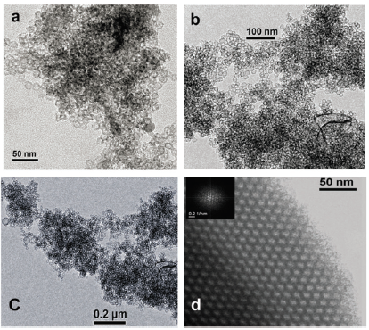
TEM Images
Swapan. K. Das, et.al. Chem. Commun. 2012, 48, 2891–2893

Slide 30
Application of TEM
Distribution and size of the pore; micropores, mesopores and macropores
Lattice distribution.
Polymer crystalline structure and morphology
Polymer composition
Distribution of disperse nanoparticles on a support matrix.

Slide 31
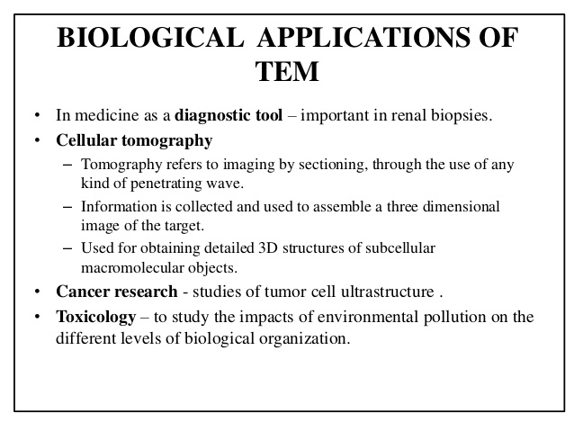

Slide 32
Comparison Optical and Electron Microscopy
Optical Microscope | Electron Microscope
The source is light The lenses used here glass items. The images you can observed in the camera in the eyepiece. The magnified image of the specimen that you can observe of resolution 200 nm (1000X magnification) | The source is the energetic electrons The lenses are replaced by a series of coil shaped electromagnets through which electron can travels. The image is formed as photograph (Electron micrograph) or as an image on a TV screen. Resolution 0.2 nm (50,000 X magnification)

Slide 33
Comparison Between SEM and TEM
TEM | SEM
) Electron beam passes through the thin sample. Specially prepared thin samples are supported on TEM grids. Specimen stage halfway down column. Image shown on fluorescent screen. Image is a 2D projection of the sample | Electron beam scan over surface of sample. Sample can be any thickness and is mounted on an aluminum stub, carbon tape. Specimen stage in the chamber at the bottom of the column. Image shown on TV monitor. Image is of the surface of the sample.

Slide 34
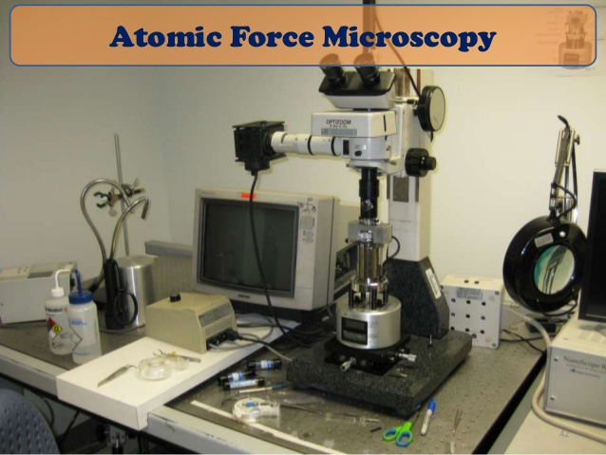

Slide 35
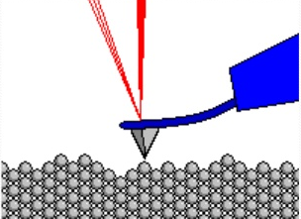
Atomic Force Microscopy (AFM)
The AFM works by scanning a probe over the sample surface building up a map of the height or topography of the surface as it goes along.

Slide 36
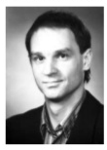
Discovery
AFM was invented by IBM scientists in 1982.
Improved AFM was invented and used by Gred Binning at. el. in 1980s which earned them noble prize in 1986.
The first commercially available AFM introduced in 1989.

Slide 37
Principle
The AFM consists of a cantilever with a sharp tip (probe) at its end that is used to scan the specimen surface.
The cantilever is typically silicon or silicon nitride with a tip radius of curvature on the order of nanometers.
When the tip is brought into proximity of a sample surface, forces between the tip and the sample lead to a deflection of the cantilever.
Depending on the situation, forces that are measured in AFM.
Forces are such as mechanical contact force, van der Waals forces, capillary forces, chemical bonding, electrostatic forces, magnetic forces, solvation forces, etc.
Then, AFM can generate an accurate topographic map of the surface features.

Slide 38
Scanning Modes
There are different imaging modes of AFM.
Contact mode.
Non-contact mode.
Tapping mode.

Slide 39
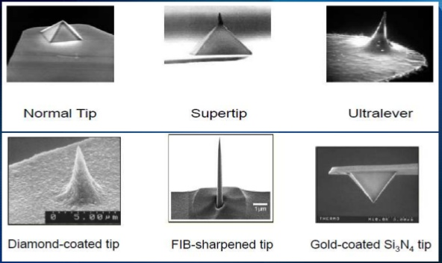
AFM Tips

Slide 40
Modes of Operation in AFM
Mode of Operation | Force of Interaction
Contact mode (repulsive) Non-contact mode weak (attractive) Tapping mode strong | Constant force or constant height. Vibrating probe Vibrating probe

Slide 41
Contact Mode
Characteristics of Contact mode
High resolution images
Tip of the probe always touching the sample.
Fasted of all the topographic modes.
Because of repulsive forces tip and sample may damage.
Sensitive to the nature of sample.
Not good for soft samples.

Slide 42
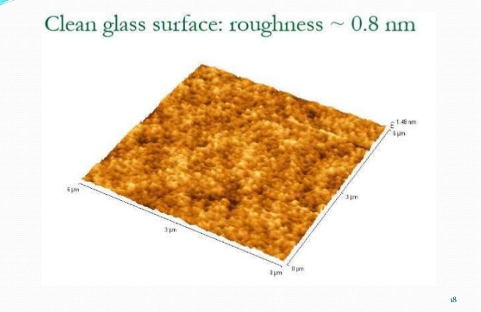
Contact Mode: Clean Glass Surface

Slide 43
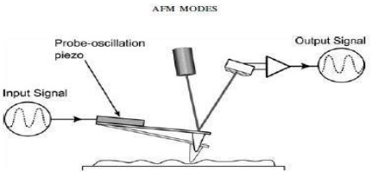
Non-Contact Mode: Clean Glass Surface
Characteristics of Non-contact mode
Signal-to-noise benefits associated with modulated signals.
Oscillating modes can measure images with a small probe-sample force.

Slide 44
Tapping Mode
Characteristics of trapping mode
No capillary effect.
Amplitude signals are used in feedback.
Used for imaging in air.

Slide 45
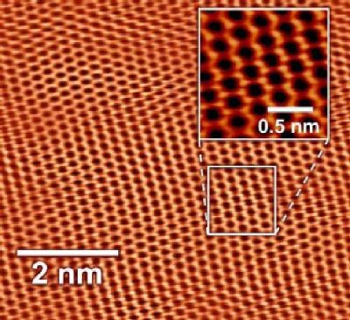
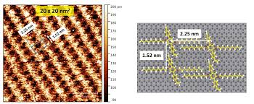
Some images

Slide 46
Applications
Digitally images a topographical surface.
Determine the roughness of a surface sample or to measure the thickness of a crystal growth layer.
Any sample like ceramic material, human cell or individual molecules of DNA can be inspected.
Images of non-conducting surfaces such as proteins and DNA.
Antibody-antigen binding studies.
Binding force of complementary DNA strands.

Slide 47
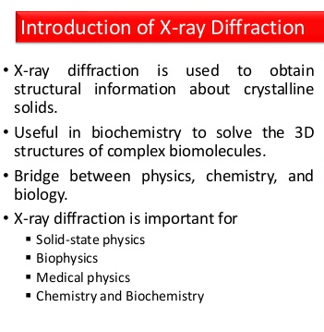
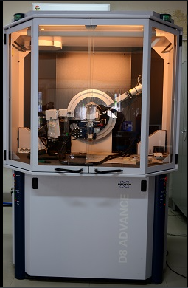

Slide 48
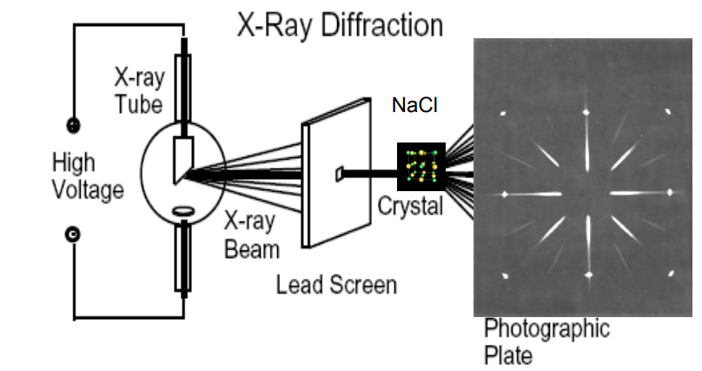
X-ray Diffraction (XRD)
X-ray Diffraction: “Every crystalline substance gives a pattern; the same substance always gives the same pattern; and in a mixture of substances each produces its pattern independently of the others.”
The X-ray diffraction pattern of a pure substance is, therefore, like a fingerprint of the substance. It is based on the scattering of X-ray by crystals.
Definition: The atomic plans of a crystal cause an incident beam of X-rays to interfere with one another as they leave the crystal. The phenomenon is called X-ray diffraction.
In 1913, Sir William Henry Bragg, and his son Sir William Lawrence Bragg developed a relationship to explain why cleavage faces of crystals appear to reflect X-ray beam at certain angles of incidence.

Slide 49
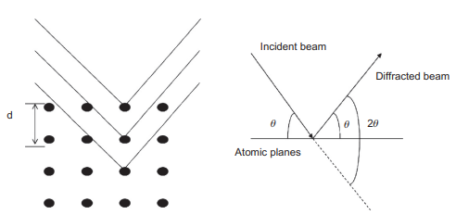
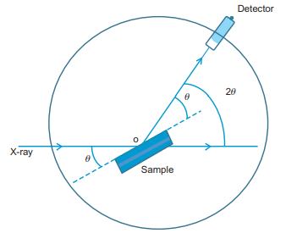
X-ray Diffraction (XRD): Principle
Crystalline materials have periodic arrangement of atoms.
When irradiated with X-rays, the electrons interact with the radiation and undergo an elastic collision to make them oscillate.
The electron cloud of the materials acts as a secondary source to generate a coherent source of electromagnetic radiation at the same frequency and phase to that incoming X-ray.

Slide 50
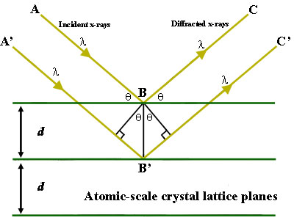
X-ray Diffraction (XRD): Principle
The emitted radiation from different atoms will undergo constructive or destructive interference.
The interaction of incident rays with the sample produces constructive interferences when satisfy Bragg’s law.
For constructive interference, the diffraction peaks are measured, recorded, and analyzed to calculate the desired set of crystal properties.
The constructive interference of the reflected beams emerging from two different planes will take place if the path lengths of two rays is equal to whole number of wavelength.

Slide 51
X-ray Diffraction (XRD): Principle
For constructive interference,
nλ = 2dsinθ
This is called Bragg’s law.
Where, assume n= 1 for the first order reflection
λ = Wave length of x-ray.
θ = x-ray incident angle.
d= distance between atomic layer.
Thus, Bragg’s law is used to estimate the spacing between two consecutive crystallographic planes parallel to the surface of a film.

Slide 52
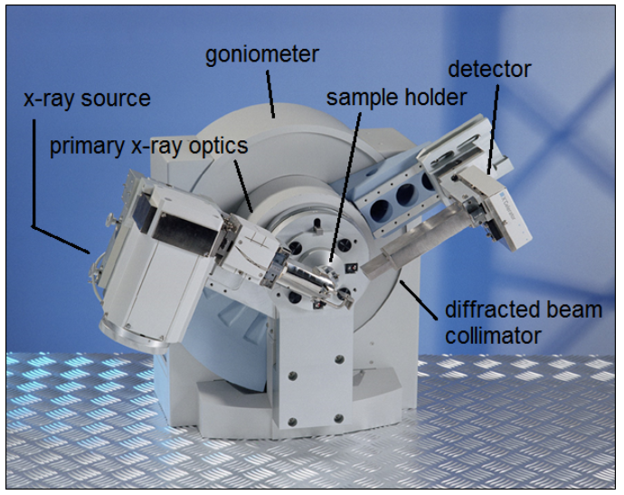
X-ray Diffraction (XRD)
Basic component
X-ray source.
β-Filter.
Device for restricting wavelength range “goniometer”
Sample holder
Radiation detector.
Signal processor and readout.
X-ray source: X-rays are produced whenever high speed electrons collide with a metal target.
A source of electrons-hot W filament, a high accelerating voltage between cathode (W) and the anode and a metal target , Cu, Al, Mo, Mg.

Slide 53
X-ray Diffraction (XRD)
Applications of XRD
Structure of crystals
Polymer characterization.
Particle size determination.
Spot counting method.
Broadening of diffraction lines.
Low-angle scattering.
Applications of diffraction methods to complexes.
Determination of isomers such as cis-trans isomerism,
Many more miscellaneous applications.

Slide 54
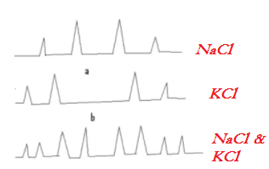
X-ray Diffraction (XRD)
Structure determination of individual crystals and mixed crystals
X-ray pattern of NaCl crystal.
X-ray pattern of KCl crystal..
X-ray pattern of mixture of NaCl and KCl.

Slide 55
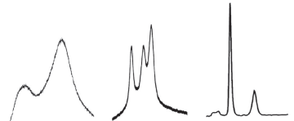
X-ray Diffraction (XRD)
Polymer Characterization
Degree of crystanility.
Non-crystalline portion scatters X-ray beam to give a continuous background (amorphous materials).
Crystalline portion caused diffraction line that are not continuous (crystalline materials)

Slide 56
Wide-angle XRD
Estimate D-spacing and Integration Into Interlayer:
The X-ray diffractogram of MMT clay showed a peak at 2θ = 4.72, with an interlayer distance of 1.87 nm but in the case of nanocomposites with PAC, the peak shifts to 2θ = 2.44, corresponding to an interlayer distance of 3.61 nm and suggesting that the polymer chains have entered the interlayer region of the clay.
nλ = 2dsinθ
d= nλ/2sinθ
= 0.15406/2Sin (4.72/2)
= 0.15406/2x0.0823
= 1.87 nm
Wave length of Cu-X-ray, λ = 0.15406 nm or 1.5406 Ǻ

Slide 57
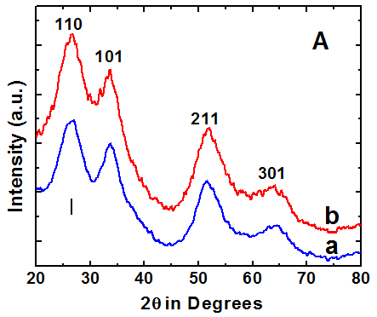
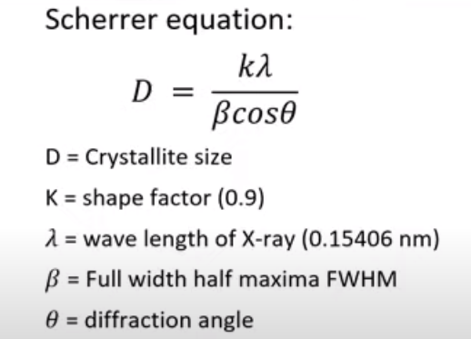
X-ray Diffraction (XRD)
Crystallite Size Determination
= 2.15 nm
= 2.15 nm
2θ = 26.58º θ = 13.29º, cos (13.29) = 0.9732, β = (π/180)x3.78 = 0.066
λ = 0.154 nm
L_{hkl} =
= 0.1386/0.0642 = 2.15 nm

Slide 58
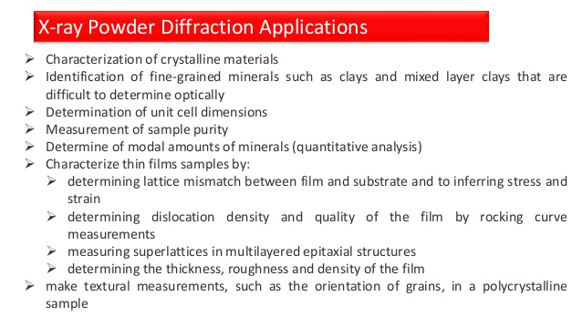

Slide 59
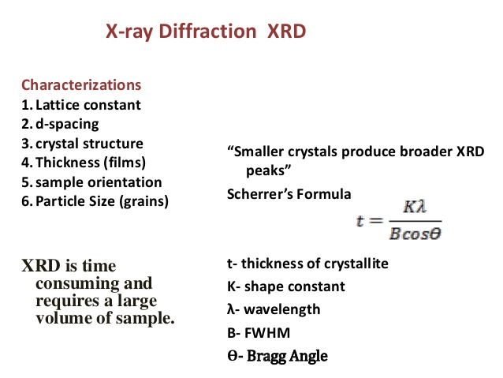

Slide 60
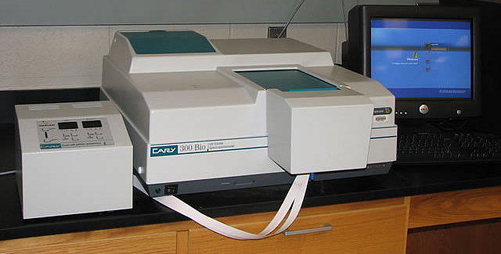
Principle and Application of ultraviolet spectroscopy
Ultraviolet-visible (UV-vis) spectroscopy is used to obtain the absorbance spectra of a compound in solution or as a solid.
What is actually being observed spectroscopically is the absorbance of light energy or electromagnetic radiation, which excites electrons from the ground state to the first singlet excited state of the compound or material.
The UV-vis region of energy for the electromagnetic spectrum covers 1.5 - 6.2 eV which relates to a wavelength range of 800 - 200 nm.
The Beer-Lambert Law is the principle behind absorbance spectroscopy.

Slide 61
Principle of Ultraviolet Spectroscopy
UV spectroscopy follows the Beer-Lambert law: Principle
when a beam of monochromatic light is passed through a solution of an absorbing substance, the rate of decrease of intensity of radiation with thickness of the absorbing solution is proportional to the incident radiation as well as the concentration of the solution.
The expression of Beer-Lambert law
A = log (I₀/I) = ЄCL; Where, A = absorbance; I₀ = intensity of light incident upon sample cell; I = intensity of light leaving sample cell; C = molar concentration of solute; L = length of sample cell (cm.); Є = molar absorptivity or molar extinction co-efficient. It is clear that greater the number of molecules capable of absorbing light of a given wavelength, the greater the extent of light absorption.

Slide 62
Ultraviolet Spectroscopy
Observed electronic transitions:
The lowest energy transition is typically an electron in the Highest Occupied Molecular Orbital (HOMO) to the Lowest Unoccupied Molecular Orbital (LUMO).
For any bond (pair of electrons) in a molecule, the molecular orbitals are a mixture of the two contributing atomic orbitals; for every bonding orbital “created” from this mixing (s, p), there is a corresponding anti-bonding orbital of symmetrically higher energy (s*, p*).
The lowest energy occupied orbitals are typically the s; likewise, the corresponding anti-bonding s* orbital is of the highest energy
p-orbitals are of somewhat higher energy, and their complementary anti-bonding orbital (p*) somewhat lower in energy than s*.

Slide 63
Principle of Ultraviolet Spectroscopy
Unshared pairs lie at the energy of the original atomic orbital, most often this energy is higher than p or s (since no bond is formed, there is no benefit in energy)
σ∗
σ
σ
π
n
n
σ∗
π∗
π∗
σ∗
π∗
alkanes
carbonyls
unsaturated compds.
O, N, S, halogens
carbonyls
π∗
Unoccupied levels
Atomic orbital
n
Atomic orbital
Occupied levels
π
σ
Molecular orbitals

Slide 64
Principle of Ultraviolet Spectroscopy
The limits the transitions that can be observed:
σ
σ
π
n
n
σ∗
π∗
π∗
σ∗
π∗
alkanes
carbonyls
unsaturated cmpds.
O, N, S, halogens
carbonyls
150 nm
170 nm
180 nm √ - if conjugated!
190 nm
300 nm √

Slide 65
Schematic Diagram of the Ultraviolet Spectrometer
log(I₀/I) = A
UV sources
I₀
I
sample
200
400
λ, nm
detector
monochromator/
beam splitter optics
I₀
I₀
reference
Two sources are required to scan the entire UV-VIS band:
Deuterium lamp – covers the UV – 200-330 nm
Tungsten lamp – covers 330-700 nm

Slide 66
Applications of UV spectroscopy
Functional Groups: UV spectroscopy is used to detect the presence or absence of chromophore in the compound. If the spectrum of a compound comes out to be transparent above 200 nm, it confirms the absence of a) Conjugation b) a carbonyl group c) Benzene or aromatic compound d) Bromo or iodo atoms.
Extent of Conjugation: With the increase in double bonds the absorption shifts towards the longer wavelength. For instance if double bond is increased by 8 in the polyenes then the spectrum appears in the visible region.
Geometrical isomers: cis-alkenes absorb at different wavelength than the trans-alkenes. The cis-isomer suffers distortion and absorbs at lower wavelength as compared to trans-isomer.

Slide 67
Applications of UV spectroscopy
Estimation of the Purity: UV spectroscopy helps to estimate the purity of a substance. The intensity of the absorption in sample compared to the reference can be used for the relative calculation of the purity of the sample substance.
Identification of an unknown compound: The spectrum of unknown compound is compared with a reference compound. If both the spectrums coincide then it confirms the identification of the unknown substance.
Qualitative & Quantitative Analysis: It can be used to find out molar concentration of solute under study qualitatively and quantitatively.

Slide 68
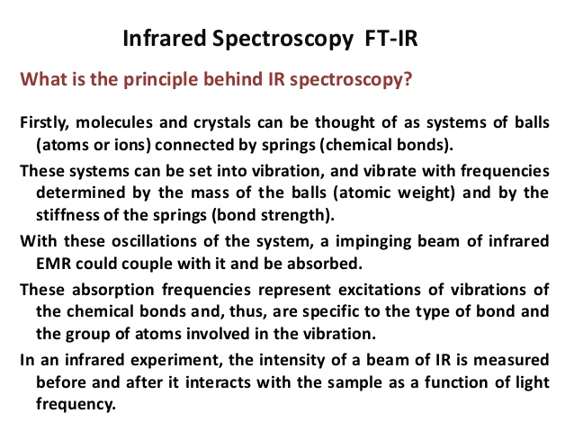

Slide 69
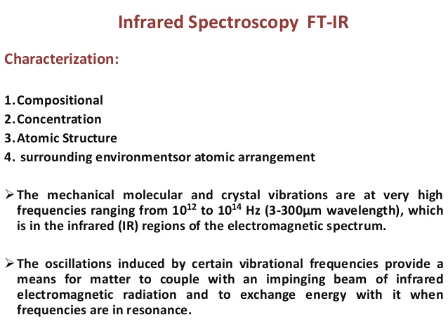

Slide 70
Principle
In IR spectroscopy the changes in the vibrational energy depends upon
i) Mass of the atoms present in a molecule.
ii) Strength of the bonds.
iii)Arrangement of atoms within the molecule.

Slide 71
Theory
When a molecule absorb radiation with a frequency less than 100 cm⁻¹, molecular rotation takes place.
If a molecule absorb more energetic radiation in the region of 10⁴ to 10² cm⁻¹, molecular vibration takes place.
A single vibrational energy change is accompanied by a large number of rotational energy changes & the vibrational spectra appear as vibrational and rotational bands.
There are three main process by which a molecule can absorb radiation, each of these route involve an increase of energy which is proportional to the absorbed light.
i) First route occurs when absorption of radiation leads to a higher rotational energy level in a rotational transition.
ii) second occurs when absorption of radiation leads to a higher vibrational energy level in a vibrational transition.

Slide 72
Theory
Two criteria must be satisfied by a molecule for the absorption of IR radiation.
i) the molecule should possess vibrational and rotational frequency.
ii) the molecule must give rise to asymmetrical charge distribution.
Three main type of absorption bands occurs in IR spectra.
i) Fundamental ; ii) Overtone; iii) Combinational

Slide 73
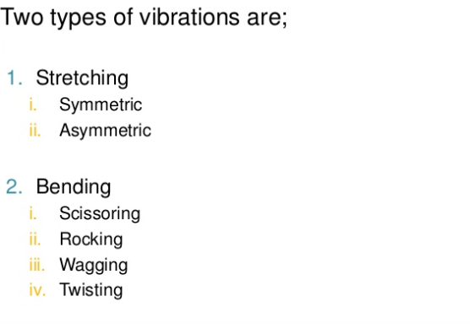
Type of Vibration

Slide 74
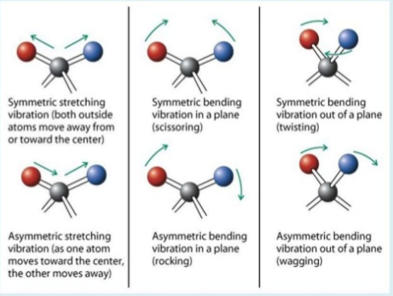
Type of Vibration

Slide 75
Applications:
Function groups determination and identification.
Distinction Between 2-Types of H-bonding: Intermolecular and Intramolecular H-bonding.
Quantative Analysis of compounds presents in a mixture.
Find out the Keto-enol Tautomerism.
Monitor to reaction progress and product formation.

Slide 76
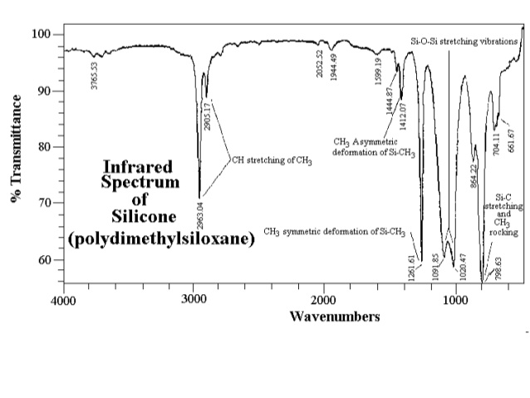

Slide 77
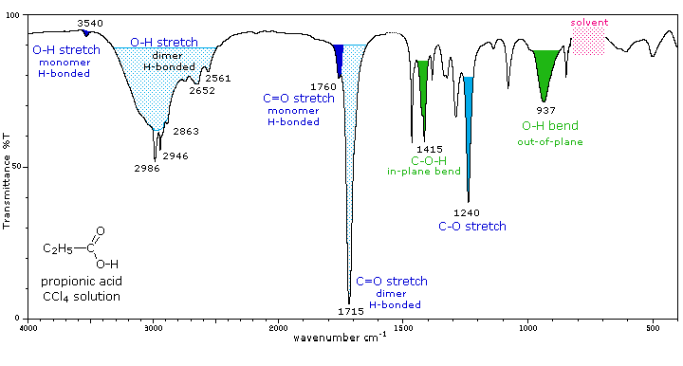
Applications: Compounds Identification

Slide 78

Applications: H-bonding & Quantative Analysis
Distinction Between 2-Types of H-bonding
If a compound having intra=molecular H-bonding, it will shows broad bands in IR spectrum.
Whereas if a compound having intermolecular H-bonding, it will shows sharp well defined bands.
For insatnce o-nitrophenol shows broad band due to the presence of intra-molecular H-bond, whereas p-nitrophenol shows sharp band due the intermolecular H-bond.
Quantative Analysis:
It can be done by measuring the intensity of the absorption bands.
i.e. xylene exists as mixture of 3 isomers which shows absorption bands as
o-xylene bands 740 cm⁻¹
m-xylene bands 880 cm⁻¹
p-xylene bands 830 cm⁻¹

Slide 79

Applications: Tautomerism

Slide 80

Applications

Slide 81

Applications: Compounds Identification
Increasing ring strain increases the C=O stretching frequency.
Increasing ring strain leads to hamper the bond stability.
This phenomenon and effective IR study helps to identify the compound.

Slide 82
Thermoanalytical Data
What is Thermal Analysis?
Thermal analysis is a series of techniques that provide physical property measurement like mass change or enthalpy change, etc as a function of temperature, time, and other variables.
Thermal Gravimetric Analysis (TGA)
Measure change in weight during heating or cooling
Differential Thermal analysis (DTA)
Measure temperature difference between the sample and reference.
Differential Scanning Calorimetry (DSC)
Measure heat absorbed or liberated during heating or cooling

Slide 83
Thermal Gravimetric Analysis (TGA)
What is the TGA?
A technique that permits the continuous weighing of a sample as a function of temperature and/or as a function of time at a desired temperature.
What Information You Can from TGA ?
Thermal Stability of Materials: Explicate decomposition mechanism, fingerprint materials for identification & quality control.
Oxidative Stability of Materials: Oxidation of metals in air, oxidative decomposition of organic substances in air/O₂, Thermal decomposition in inert atmosphere.
Composition of Multi-component Systems: Behaviours sufficiently different on temperature scale can be identified and reaction mechanism formulated.
Estimated Lifetime of a Product: Related to thermal stability.
Decomposition Kinetics of Materials: Rate of reaction, Activation Energy.
The Effect of Reactive or Corrosive Atmospheres on Materials: Oxidation & Corrosion Studies.
Moisture and Volatiles Content of Materials: Loss of moisture, drying, desorption.

Slide 84




Slide 85

Thermal Gravimetric Analysis (TGA)
Schematic Diagram of the Thermal Gravimetric Analysis (TGA)

Slide 86
Principle of TGA
In thermo-gravimetric analysis, the sample is heated in a given environment such as air, N₂, CO₂, He, Ar at controlled rate.
The change in the weight of the substance is recorded as a function of temperature or time.
The temperature is increased at a constant rate for a known initial weight of the substance and the changes in weights are recorded as function of temperature at the different time interval.
This plot of weight change against temperature is called thermo-gravimetric curve or thermo gram, this is the basic principle of TGA

Slide 87
Thermal Gravimetric Analysis (TGA)
Mechanisms of Weight Change in TGA
Weight Loss:
Decomposition: The breaking apart of chemical bonds.
Evaporation: The loss of volatiles with elevated temperature.
Reduction: Interaction of sample to a reducing atmosphere (hydrogen, ammonia, etc).
Desorption.
Weight Gain:
Oxidation: Interaction of the sample with an oxidizing atmosphere.
Absorption or Adsorption.

Slide 88

Differential Thermal analysis (DTA)
What is the DTA?

Slide 89

Differential Thermal analysis (DTA)

Slide 90

Differential Thermal analysis (DTA)
Information of the Endothermic Peak of the DTA?

Slide 91

Differential Thermal analysis (DTA)
Information of the Exothermic Peak of the DTA?

Slide 92

Differential Thermal analysis (DTA)
List of Reference Materials used in the DTA Study?

Slide 93

TGA and DTA: Calcium Oxalate Monohydrate
H₂O
CO
CO₂
Weight (%)
Derivative Weight (%)/min

Slide 94
TGA and DTA: Calcium Oxalate Monohydrate
1st Step, H₂O Release
CaC₂O₄•H₂O (s) → CaC₂O₄ (s) + H₂O (g)
2nd Step, CO Release
CaC₂O₄ (s) → CaCO₃ (s) + CO (g)
3rd Step, CO Release
CaCO₃ (s) → CaO (s) + CO₂ (g)
Calcium oxalate monohydrate CaC₂O₄.H₂O is stable up to 100 ⁰C.
Release of water begins at 100 ⁰C and gets completed at 170 ⁰C.
Then, it shows thermal stability in the range of 170 - 400 ⁰C.
The decomposition of CaC₂O₄ to CaCO₃ with the elimination of CO occurs in the temperature range of 400-480 ⁰C.
Thermal stability of CaCO₃ in the temperature range 480-650 ⁰C.
Above 650 ⁰C CaCO₃ decomposes to CaO and CO₂.
The DTA analysis also showed corresponding three endothermic peaks.

Slide 95

TGA and DTA: CuSO₄. 5H₂O

Slide 96
TGA and DTA: CuSO₄. 5H₂O
1st Step, Release of 2H₂O Molecules
CuSO₄•5H₂O (s) → CuSO₄•3H₂O + 2H₂O ↑
2nd Step, Release of another 2H₂O Molecules
CuSO₄•3H₂O → CuSO₄•H₂O + 2H₂O ↑
3rd Step, Release of rest H₂O Molecule
CuSO₄•H₂O → CuSO₄+ H₂O ↑
4th Step, Release of SO₂ and 1/2O₂
CuSO₄→ CuO +SO_{2↑}+1/2O₂.
5th Step, Release of O₂
CuO → Cu₂O +1/2O₂

Slide 97
CHEMOFFICE
What is the ChemOffice?
ChemOffice is a scientific tool to efficiently keep track of their work, gain a deeper understanding of their data and produce scientific reports professionally and efficiently.
Applications
ChemDraw
ChemDraw is used by hundreds of thousands of scientists around the world to quickly and effectively to draw molecules and reactions for use in documents and electronic lab notebooks.
It is also used to search databases, and to generate accurate names from structures and to predict properties and spectra.

Slide 98
CHEMOFFICE
ChemDraw Excel
ChemDraw Excel adds chemical intelligence to Excel spreadsheets so that chemists can use Excel’s analysis, sorting and organization tools to further manipulate.
The enrich sets of compounds and data and explore structure-activity relationships
Chem3D
Chem3D generates 3D models so that chemists can view their compounds in three dimensions to assess shape and properties to maximize activity or specificity.
ChemFinder
ChemFinder is a chemically-intelligent personal database system that scientists use to organize their compounds and to search for and correlate structures with properties.

Slide 99

ImageJ
What is ImageJ?
ImageJ is a Java-based image processing program.
Applications:
ImageJ can display, edit, analyze, process, save, and print 8-bit color and grayscale, 16-bit integer, and 32-bit floating point images.
It can read many image file formats, including TIFF, PNG, GIF, JPEG, BMP, DICOM, and FITS, as well as raw formats.
ImageJ supports image stacks, a series of images that share a single window, and it is multithreaded, so time-consuming operations can be performed in parallel on multi-CPU hardware.

Slide 100
ImageJ
ImageJ can calculate area and pixel value statistics of user-defined selections and intensity-thresholded objects.
It can measure distances and angles. It can create density histograms and line profile plots.
It supports standard image processing functions such as logical and arithmetical operations between images, contrast manipulation, convolution, Fourier analysis, sharpening, smoothing, edge detection, and median filtering.
It does geometric transformations such as scaling, rotation, and flips.
The program supports any number of images simultaneously, limited only by available memory.

Slide 101

Origin (Data Analysis Software)
What is Origin ?
Origin is a proprietary computer program for interactive scientific graphing and data analysis.
It is produced by OriginLab Corporation, and runs on Microsoft Windows.
Origin is primarily a GUI software with a spreadsheet front end.
Unlike popular spreadsheets like Excel, Origin's worksheet is column oriented.
Each column has associated attributes like name, units and other user definable labels.
Instead of cell formula, Origin uses column formula for calculations.

Slide 102
Origin (Data Analysis Software)
Recent versions of Origin have introduced and expanded on batch capabilities, with the goal of eliminating the need to program many routine operations.
Instead the user relies on customizable graph templates, analysis dialog box.
Themes which save a particular suite of operations, auto recalculation on changes to data or analysis parameters, and Analysis Templates™ which save a collection of operations within the workbook.
Origin also has a scripting language (LabTalk) for controlling the software, which can be extended using a built-in C/C⁺⁺-based compiled language (Origin C).
Other programming options include an embedded Python environment, and an R Console plus support for Rserve.

Slide 103
Origin (Data Analysis Software)
Origin can be also used as a COM server for programs which may be written in Visual Basic .NET, C#, LabVIEW, etc.
Origin project files (.OPJ) can be read by the open-source LabPlot or SciDAVis software. The files can also be read by QtiPlot but only with a paid "Pro" version. Finally the liborigin^{[1]} library can also read .OPJ files such as by using the opj2dat script, which exports the data tables contained in the file.
There is also a free component (Orglab) maintained by Originlab that can be used to create (or read) OPJ files. A free Viewer application is also available.

Slide 104

Molecular Docking
In the field of molecular modeling, docking is a method which predicts the preferred orientation of one molecule to a second when a ligand and a target are bound to each other to form a stable complex.
The associations between biologically relevant molecules such as proteins, peptides, nucleic acids, carbohydrates, and lipids play a central role in signal transduction.
Furthermore, the relative orientation of the two interacting partners may affect the type of signal produced (e.g., agonism vs antagonism). Therefore, docking is useful for predicting both the strength and type of signal produced.

Slide 105
Molecular Docking
One can think of molecular docking as a problem of “lock-and-key”, in which one wants to find the correct relative orientation of the “key” which will open up the “lock” (where on the surface of the lock is the key hole, which direction to turn the key after it is inserted, etc.).
Here, the protein can be thought of as the “lock” and the ligand can be thought of as a “key”.
Molecular docking may be defined as an optimization problem, which would describe the “best-fit” orientation of a ligand that binds to a particular protein of interest.

Slide 106
Backscattered Electrons: backscattered (reflected) electrons which are emitted by elastic scattering of the incident (primary) electrons. have the same energy as incident electrons and display intensity or contrast variations that depend on atomic number (Z).
Secondary Electrons: Secondary electrons, however, originate from the atoms of the sample. They are a result of inelastic interactions between the electron beam and the sample.
Differences between Backscattered electrons and Secondary electrons:
Backscattered electrons are reflected back after elastic interactions between the beam and the sample. Secondary electrons, however, originate from the atoms of the sample. They are a result of inelastic interactions between the electron beam and the sample.

